Slide 1

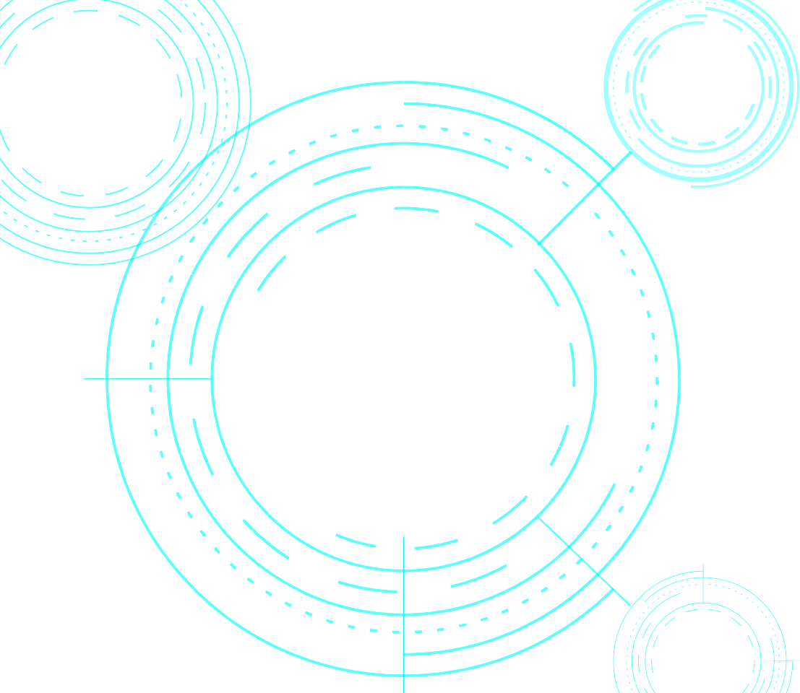

CHATNOW
An Intelligent Bot

Slide 2


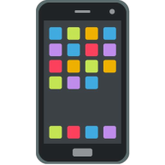
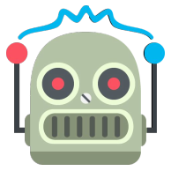
CHATBOT ??
WHAT DOES IT MEAN ?
A program designed to simulate an intelligent conversation with one or more human users via CONVERSATIONAL INTERFACE
Powered by AI(NLP) to understand context and perform
WHY NOW?
Digital growth coming from mobile usage
Distribution channels shift >> >>
Chat apps can be thought as the future browsers ;bots will be the new websites. This is the beginning of new Internet –Ted Livingston, Founder of Kik

Slide 3

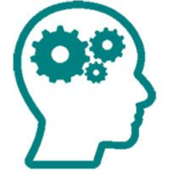

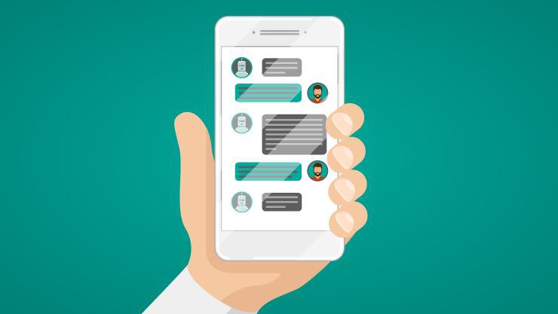


Large Picture Slide
HOW CHATBOT WORKS???
I am looking for personal loan banks in Melbourne
Intent: Banks :
Entities:
Bank type: Personal loan
Area: Melbourne
CHAT BOT RESPONDS BASED ON HOW IT WAS TRAINED FOR THE SPECIFIC INTENT AND ENTITIES

Slide 4




FRAMEWORK ANALYSED
Watson
(IBM)
Recast.AI (SAP)
MICROSOFT BOT FRAMEWORK
Widely Used
Great GUI to create slots and intents
Ease of usage
Deployment is hassle free
Rich skills and intents GUI
GitHub fork for intents reuse
Widely known
Communication is API based

Slide 5
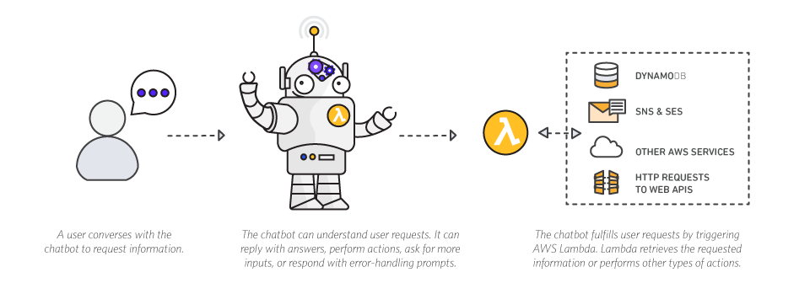

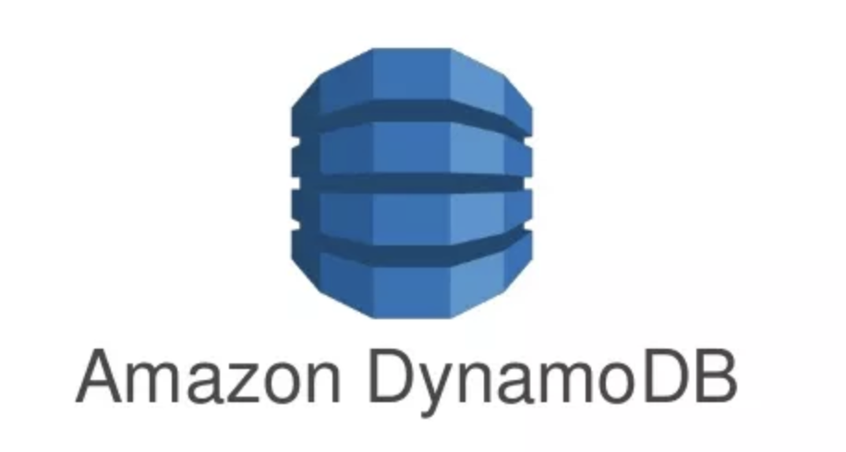
AMAZON MATTERS ??
It is a fully managed service: Lex runs on Amazon.
Fully Managed Service: Lex Runs in amazon Infrastructure
Lex is powered by Amazon Alexa
Integrated with AWS Lambda

Slide 6
PLANNING
Sprint-2:
Integration of Amazon Lex to Demo Website.
Chatbot Interface
Analyzing the Intents and entities of the client
Custom API’S
Sprint-1:
Analyzing chatbot frameworks and testing it .
Understanding the clients website and FAQ
Website Creation

Slide 7
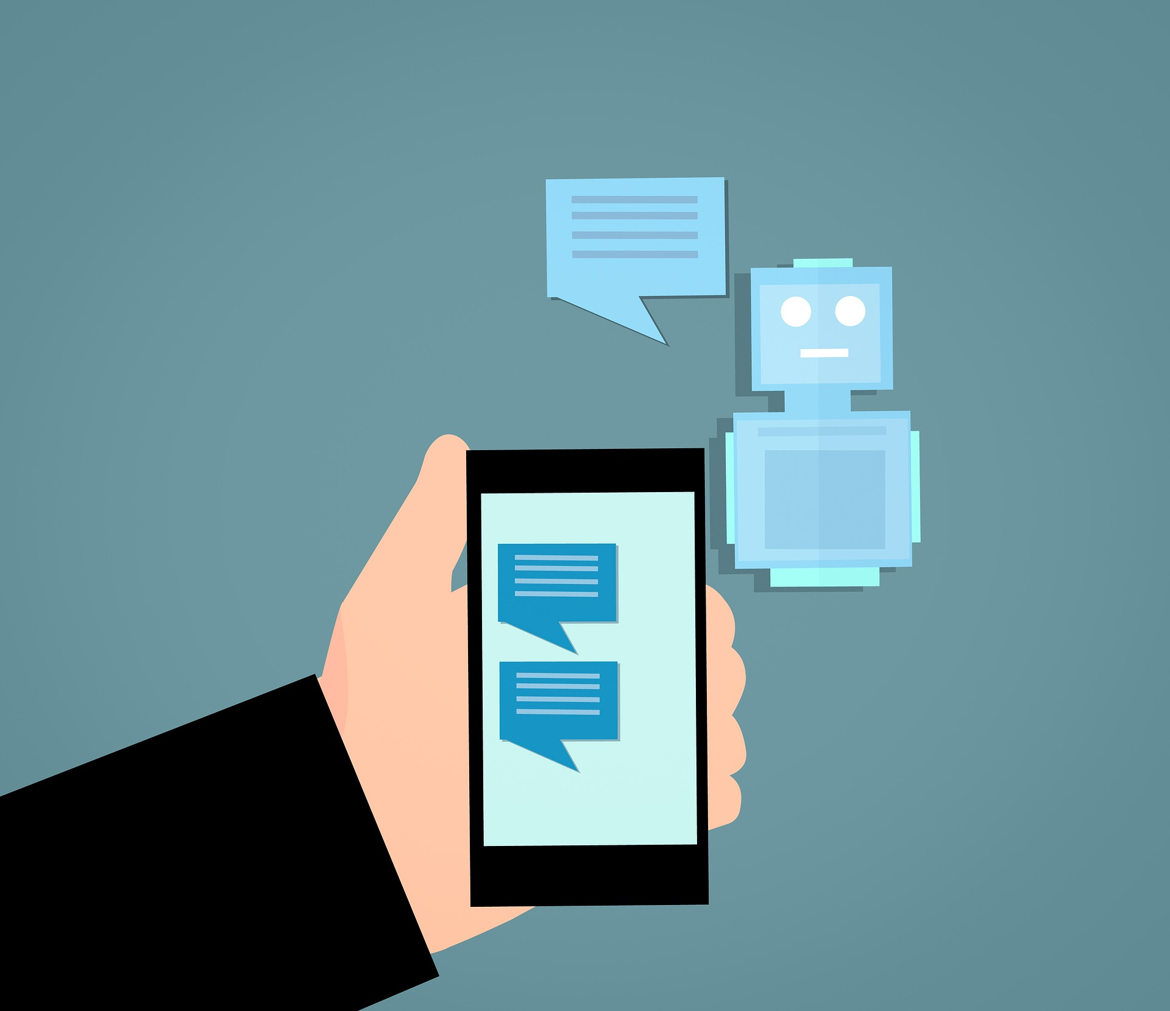



Our Product Using
FUTURE VALUE CREATION
Available round the clock for conversation help with customers -24/7
Channel Agnostic- Channels mobile, web etc.
Real Language support
Simple Interface text, image and widgets
Instant responses
Remembering customer preferences and remember users history
Reduces TAT
“The survey included responses from 800 decision makers of the company ,80% of respondents said they already used or planned to use chatbots by 2020.” — BI Intelligence /Business Insider
Unique Prototype solution
Collaborative channel integration
Authentic and Tested

Slide 8





COLLABORATIVE CHANNEL INTEGRATION

Slide 9

KEY CHARACTERISTICS
Quick Response time
Customer Experience
Intelligent Assistance
Personalized Experience
Representative of the company
70 % of consumers say they prefer messaging over calling customer support
By 2020, 85% of all customer interactions will be handled without human agents

Slide 10

HOW CHATBOTS ARE HELPFULL?
Rich UI Elements
Predefined templates and elements help in enriching the UI and UX in conversation
Users can interact through text and images.
Quick replies, buttons specific to messaging network such as
Supportive Conversation
Inputs are used to support user flows,shortcuts ,advanced user input and minimize typing effort for users
Canonical interface
All the channels of the companies can be combined into an canonical interface
History of Every Interaction

Slide 11

THE CHATNOW-B TEAM
TEAM LEAD
PRODUCT OWNER
UI/UX DESIGNER
FRONT END Developer - 1
Prajwal Kumar
Nehal Pasha
Sai Charan
Arslan
FRONT END Developer - 2
Mounika
BACK END Developer - 2
BACK END Developer - 1
Trushar
Annamalai

Slide 12
THANK YOU
CHATNOW
https://chatnowb.now.sh/

